Slide 1
Wine Data Analysis
Everything happens for a Riesling: Uncorking the science of wine making.
Notes:
Payden

Slide 2

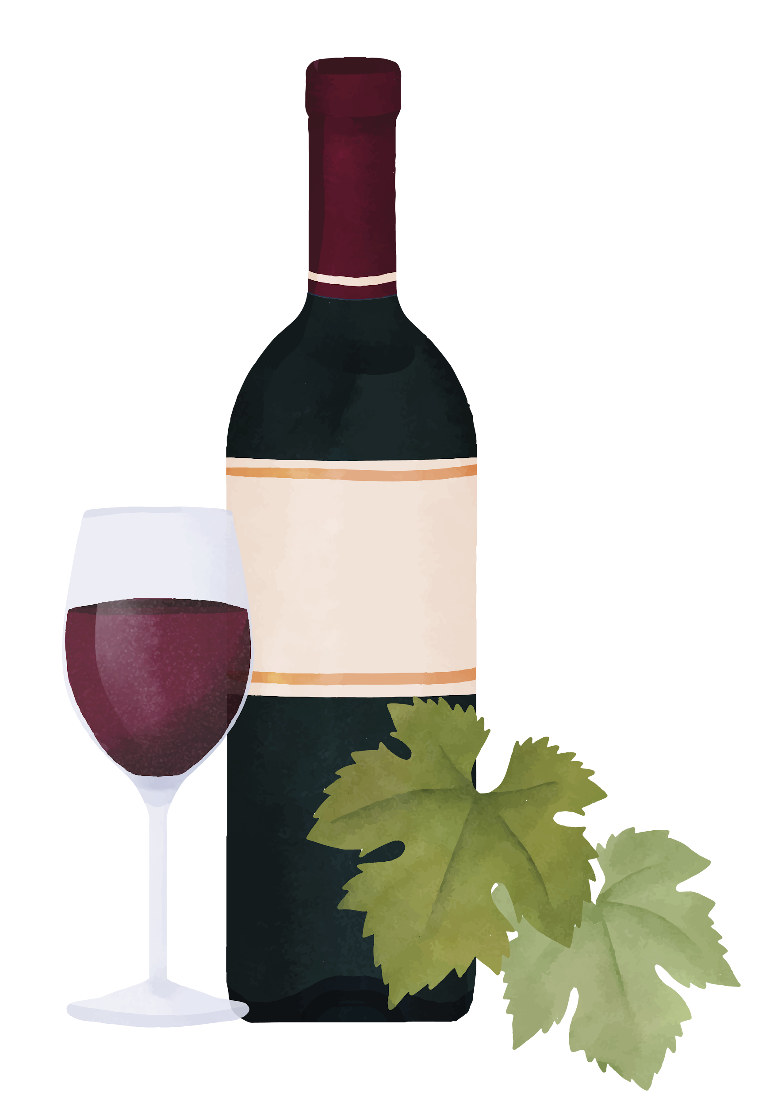
Presenters: Cherokee Carr Jack Pehlke Payden Bullis
Whoa!
Notes:
Payden

Slide 3
Table of contents
01
02
EDA
Factors and details
Data visualization
Key variables for predictability
Contents
Notes:
Payden

Slide 4

Introduction
What variables result in the best quality wines?
Introduction
Notes:
Payden

Slide 5
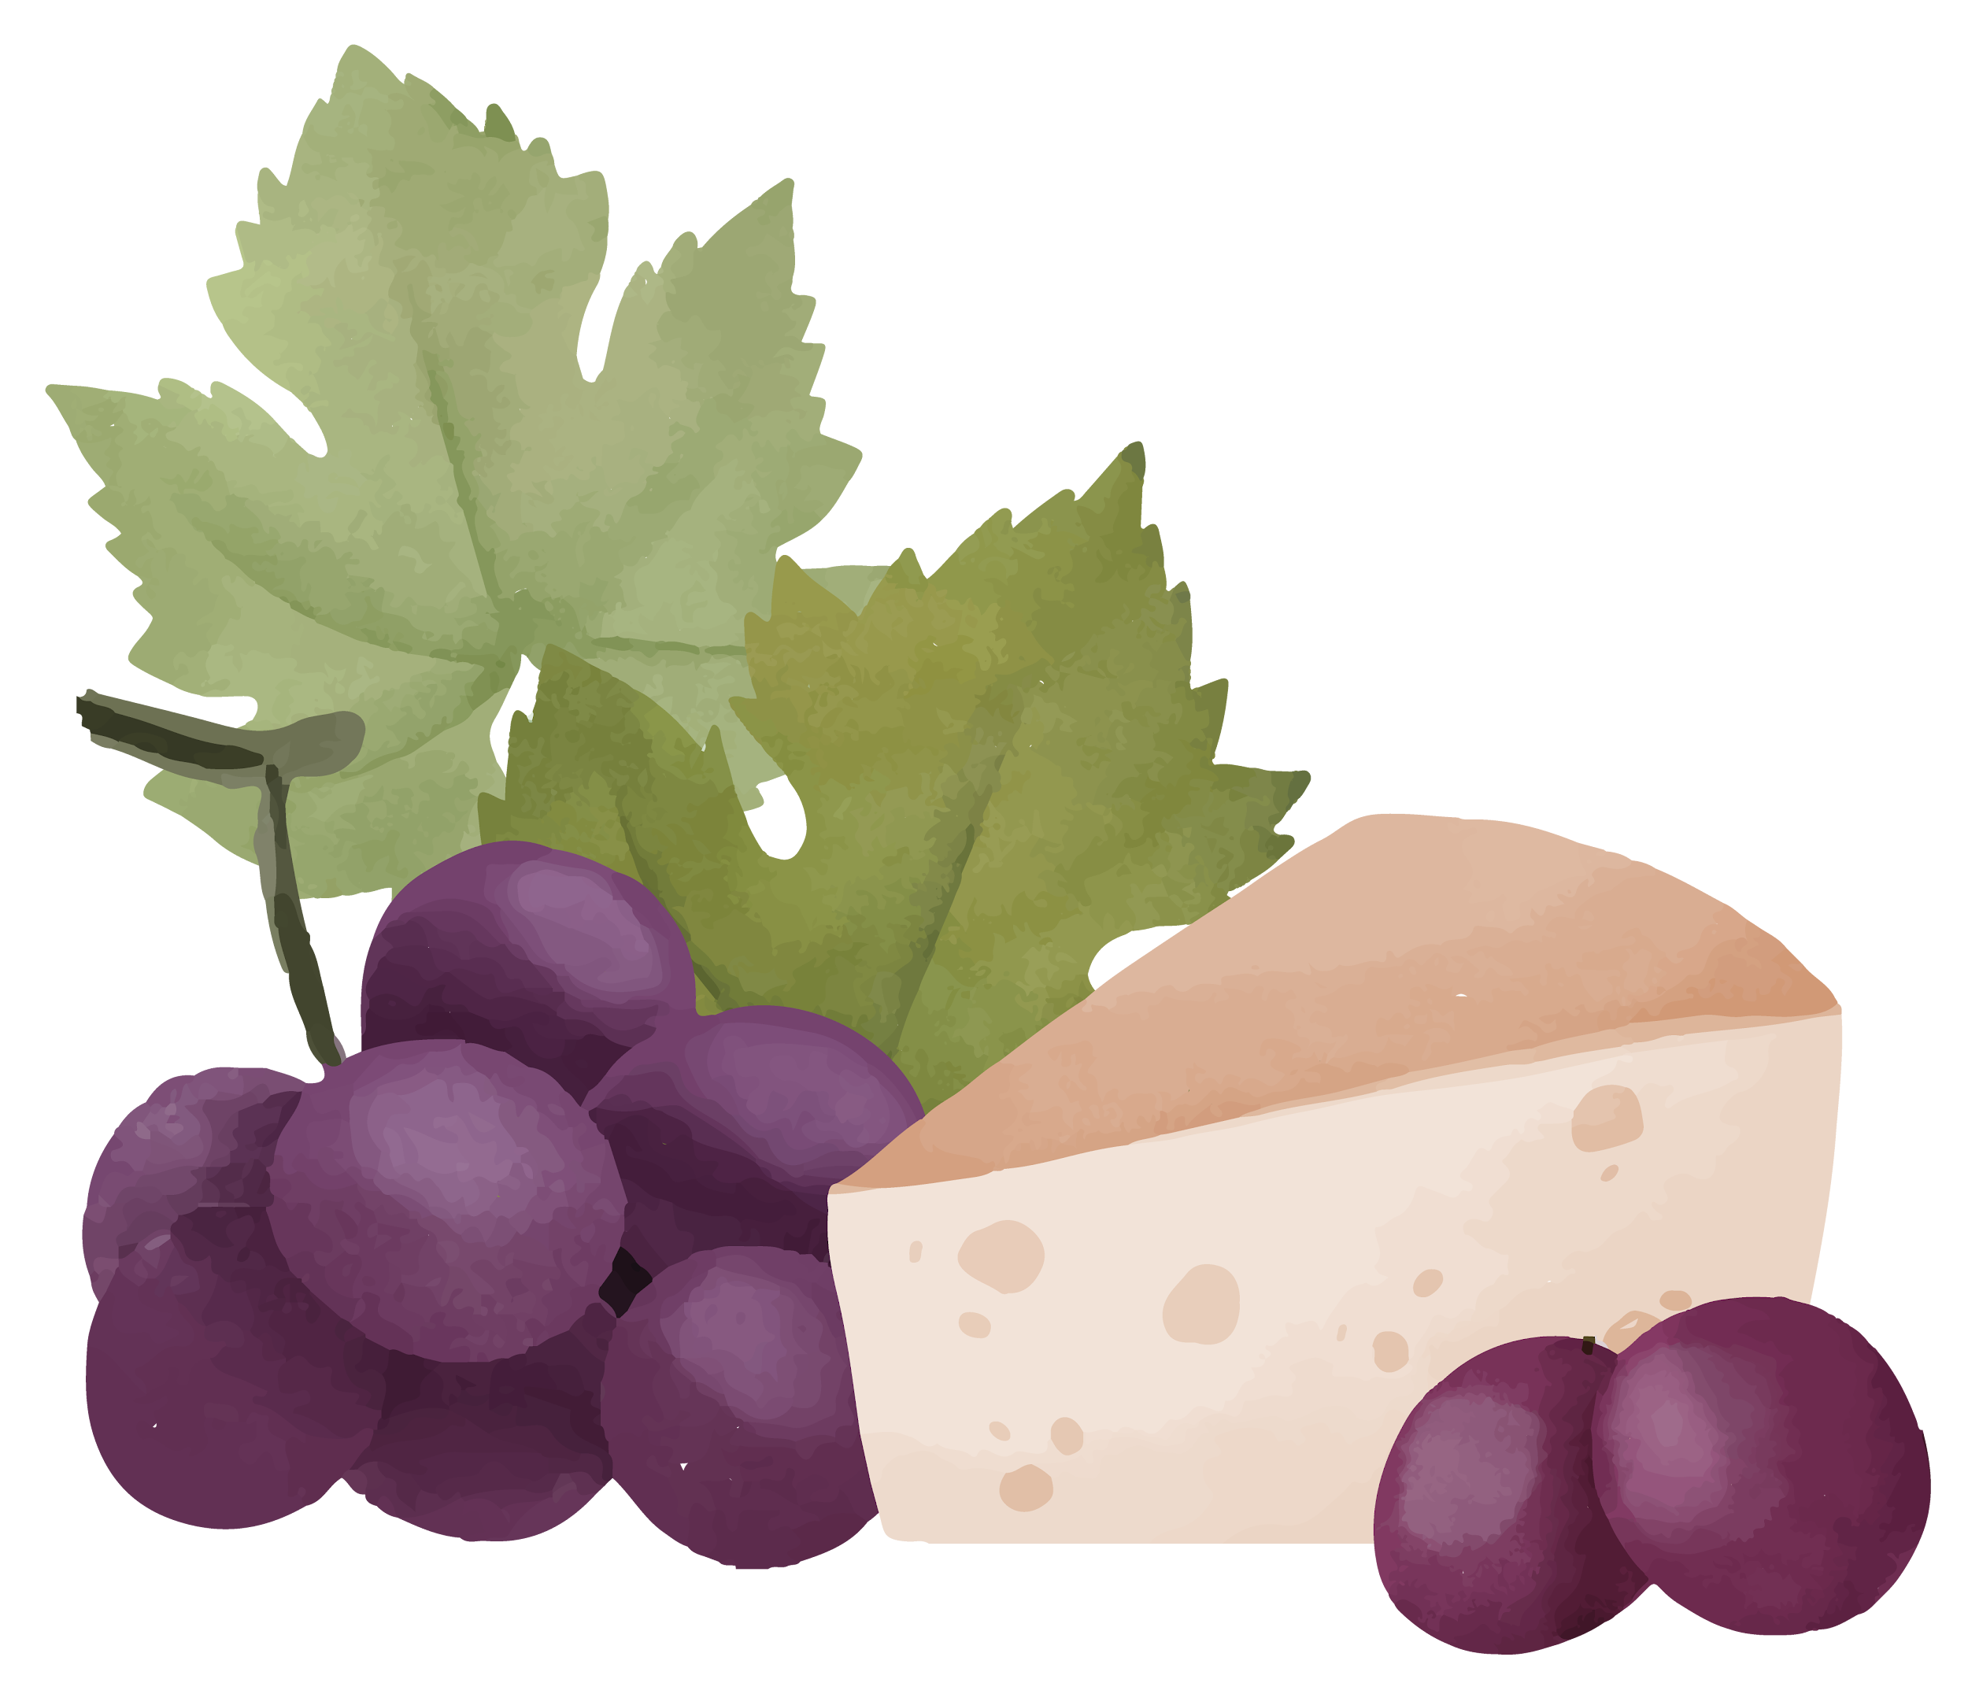
01
EDA
Visualizations and predictive factors
Exploratory Data Analysis
Notes:
Payden

Slide 6
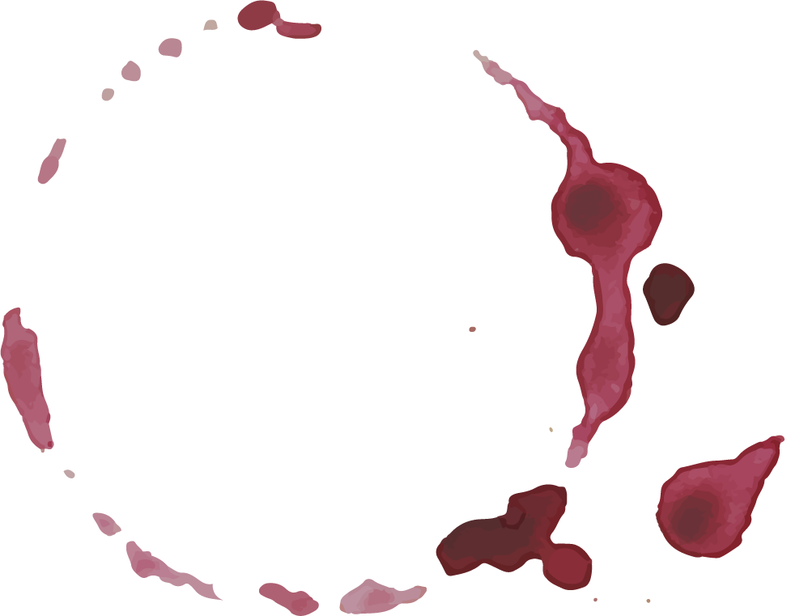

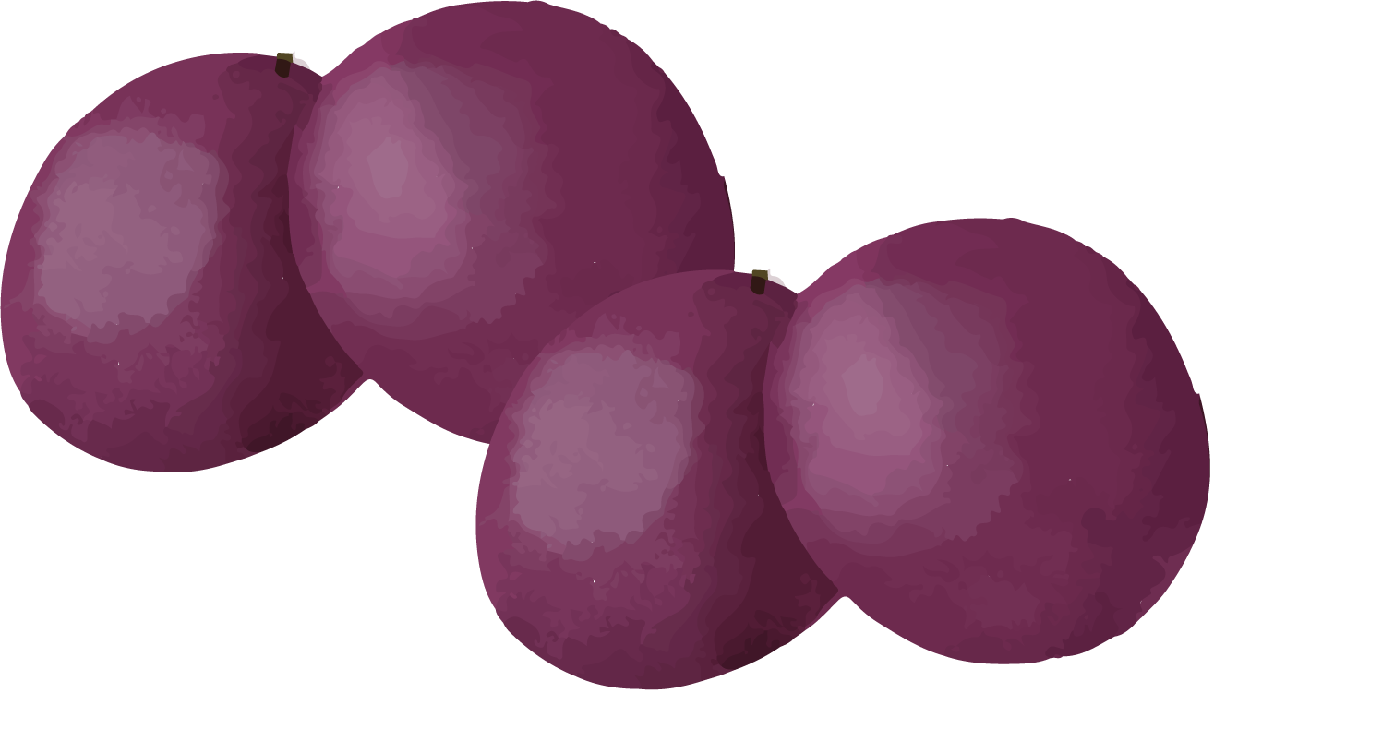
Variable Analysis
Type – Red & White
Location
Red and White wines had some differences in their predictors
California and Texas wines
Notes:
Payden

Slide 7

Variable Analysis
Density
pH
Acidity
Defined as Mass per unit volume 20°C and measures the volume of alcohol and sugars.
Potential of hydrogen (pH) is a concentration of Hydrogen Ions in wine
Fixed vs Volatile – Fixed Acids stay liquid when boiled vs volatile acids evaporate easily
Citric Acid
Notes:
Payden

Slide 8
Variable Analysis
Alcohol Content
Residual Sugars
Other Variables
Measure of Alcohol by volume this is related to the density
Measure of sugars left after fermentation
Sulfurs – Free and Total
Sulphates
Chlorides
Notes:
Payden

Slide 9
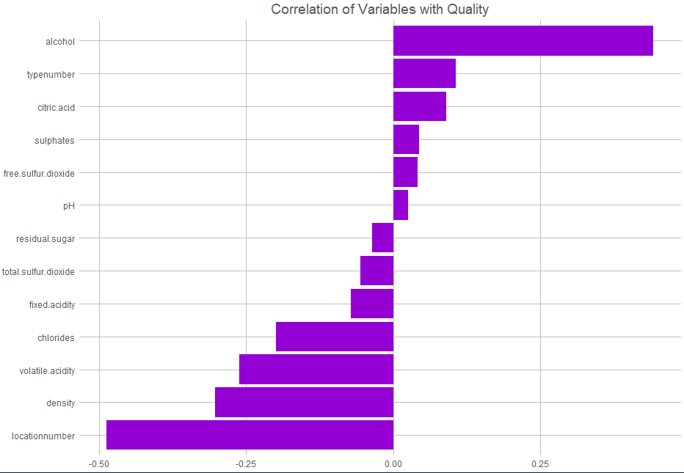
Correlation Matrix – All Wines
Location, Alcohol, Density

Slide 10
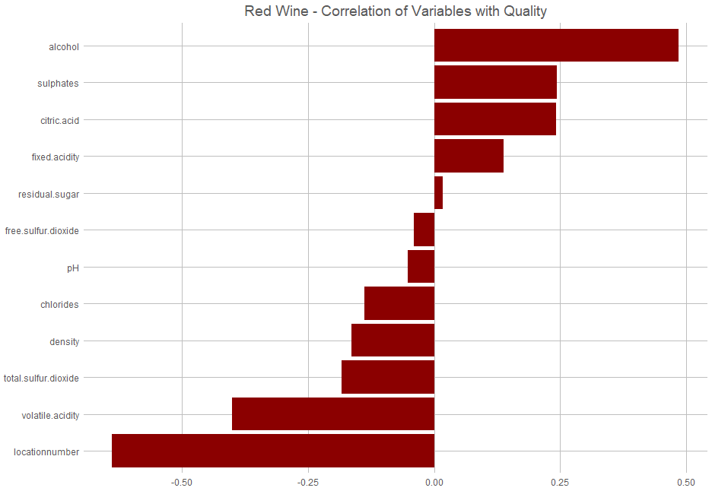
Correlation Matrix – Red Wines
Location, Alcohol, Volatile Acidity

Slide 11
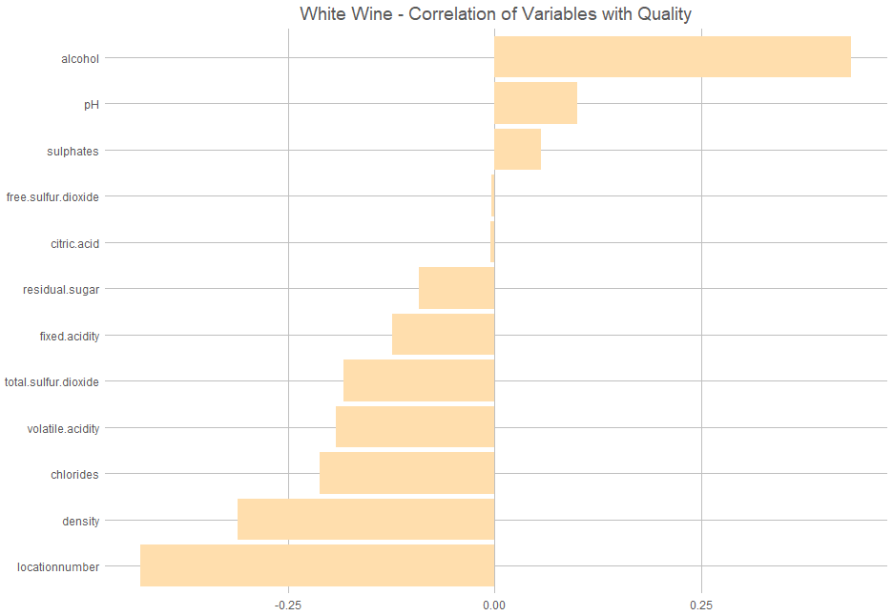
Correlation Matrix – White Wines
Location, Alcohol, Density

Slide 12
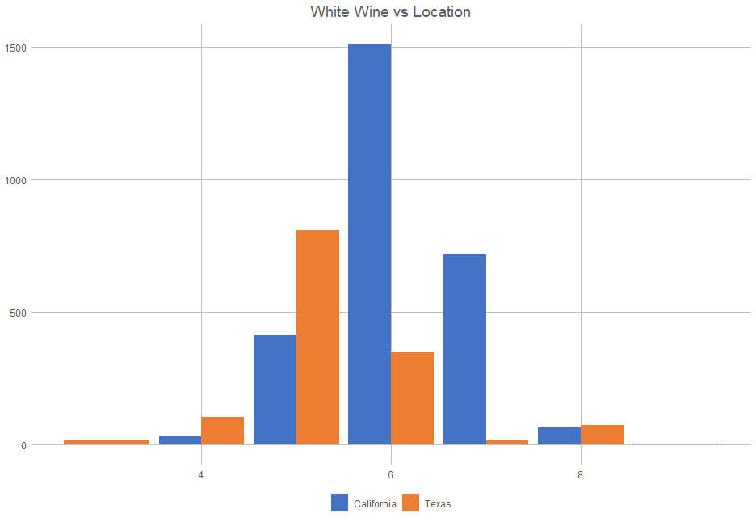
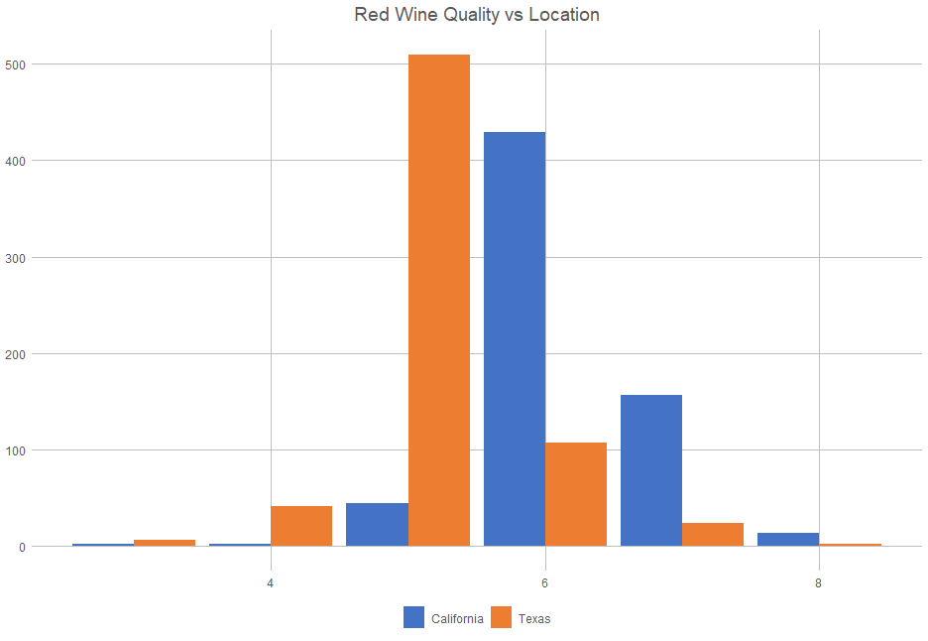
Location & Quality
White Wine
Red Wine

Slide 13
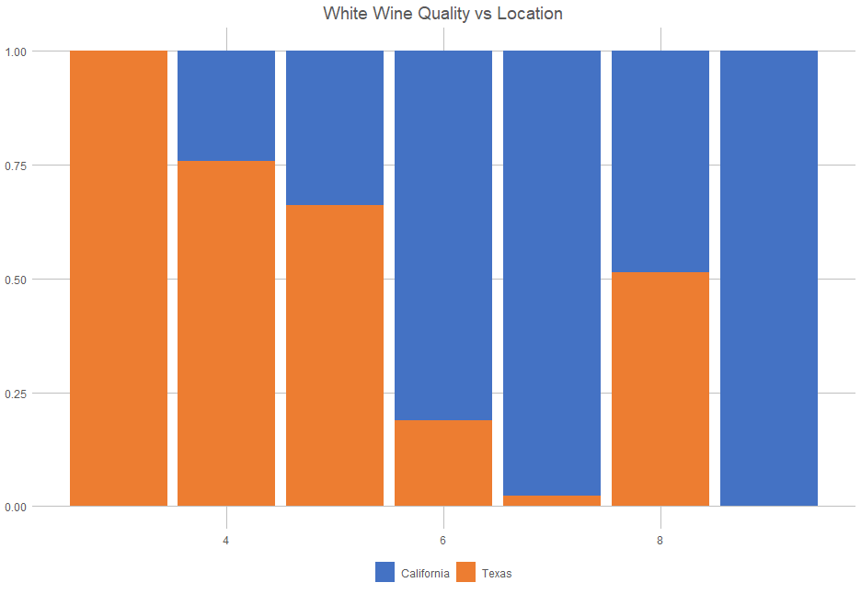
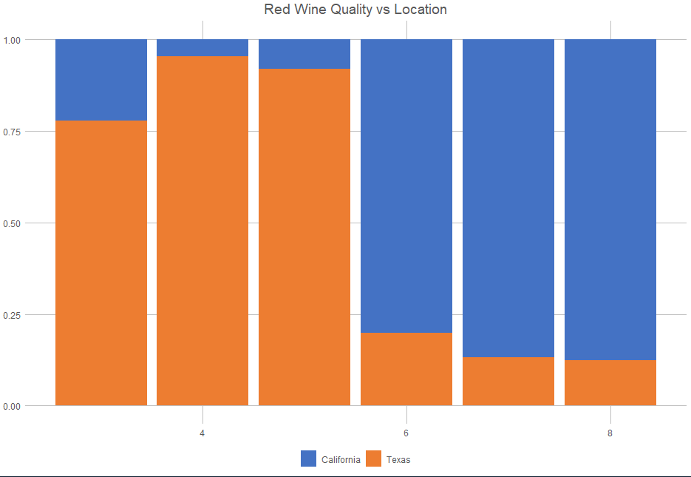
Location & Quality
White Wine
Red Wine

Slide 14
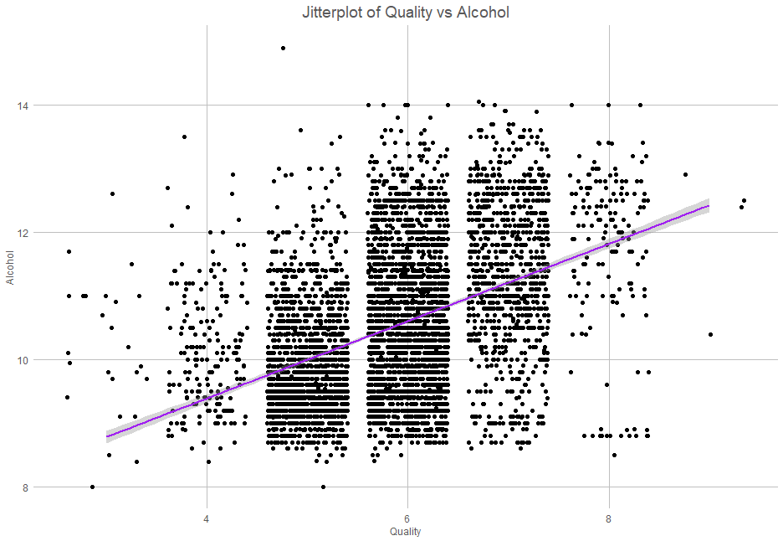
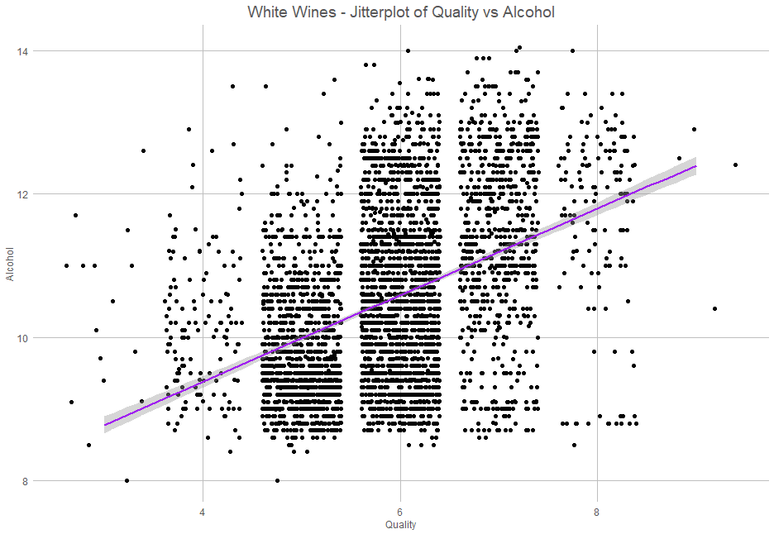
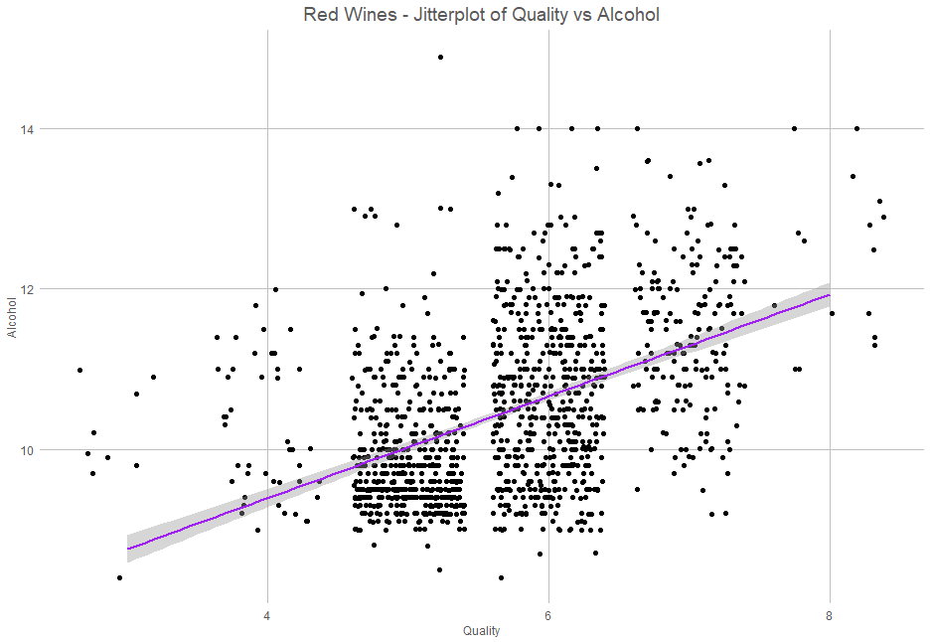
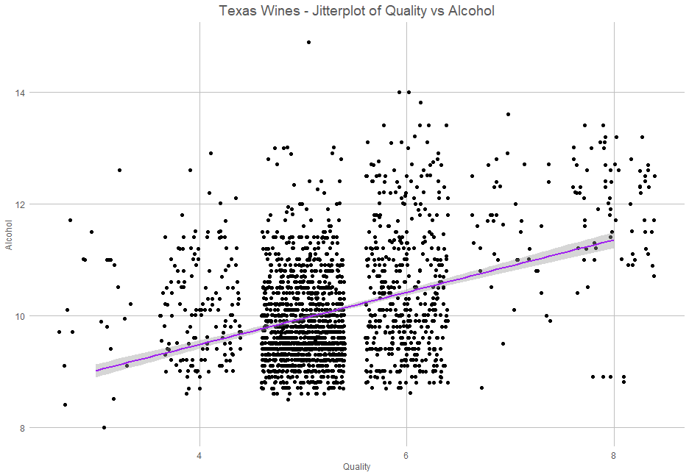
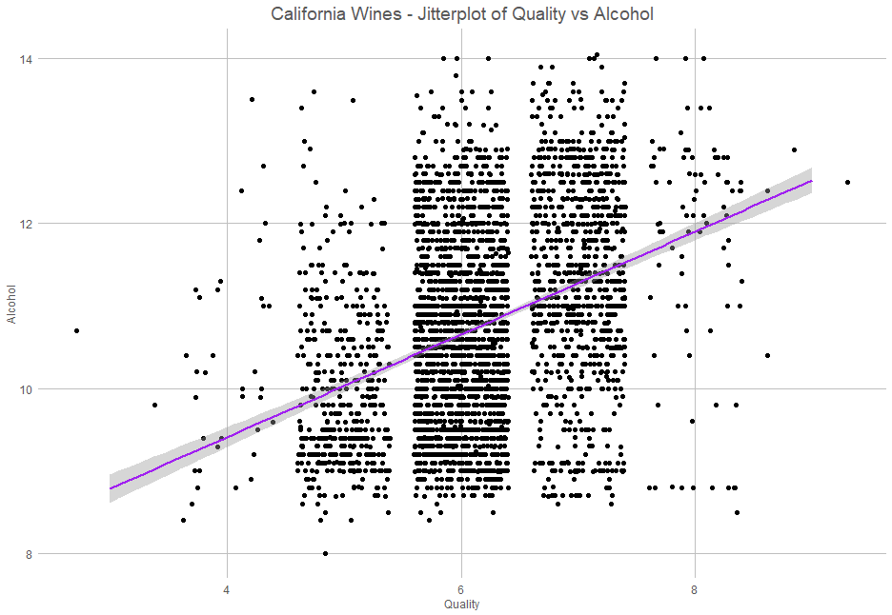
Variable Analysis - Alcohol
All Wines
White Wines
Red Wines
CA Wines
TX Wines
Notes:
Payden

Slide 15
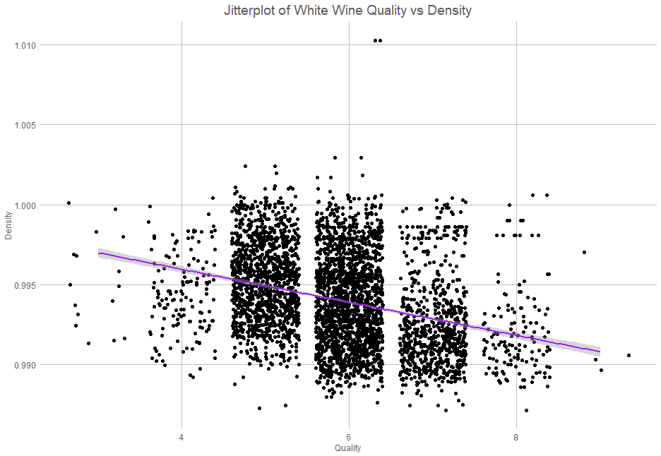
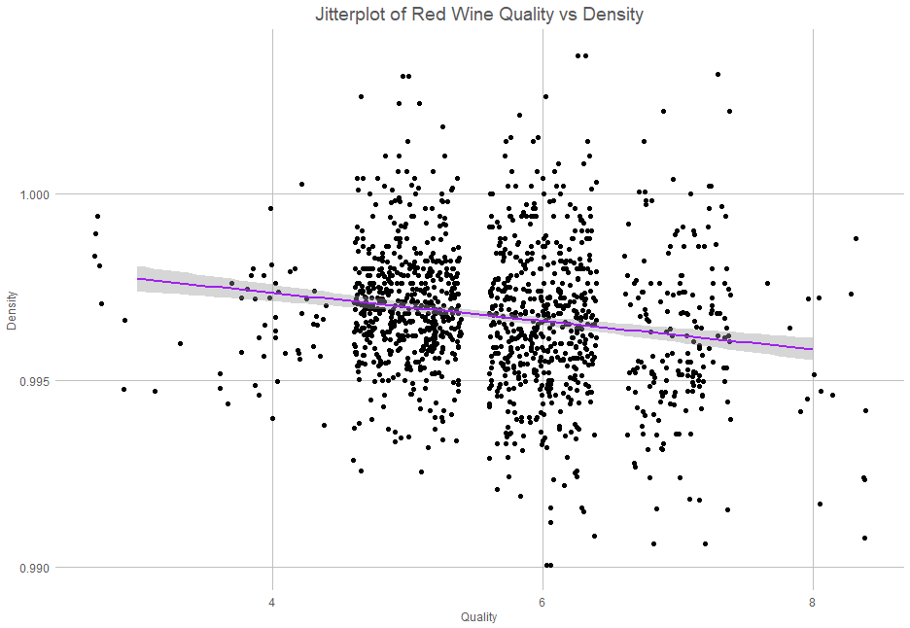
Variable Analysis – Density
White Wine
Red Wine
Notes:
Payden

Slide 16
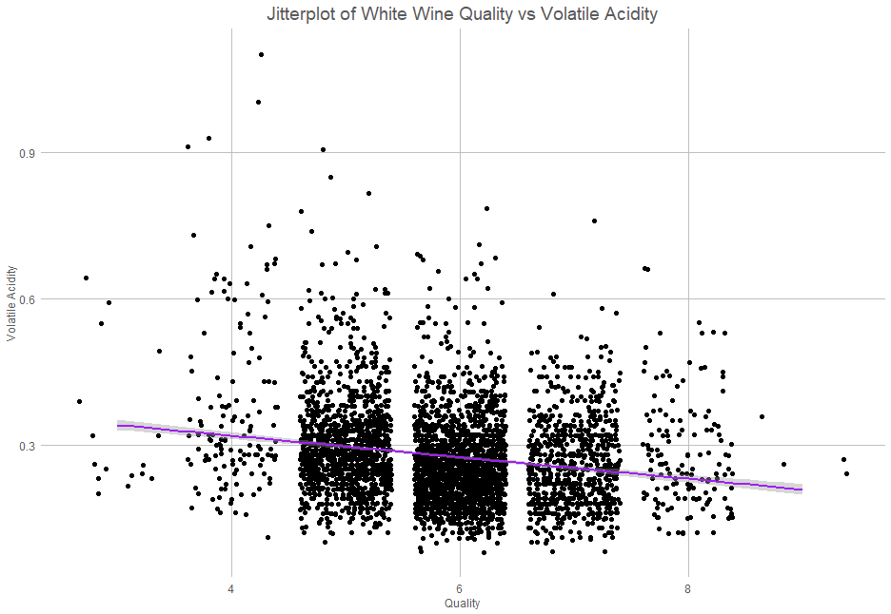
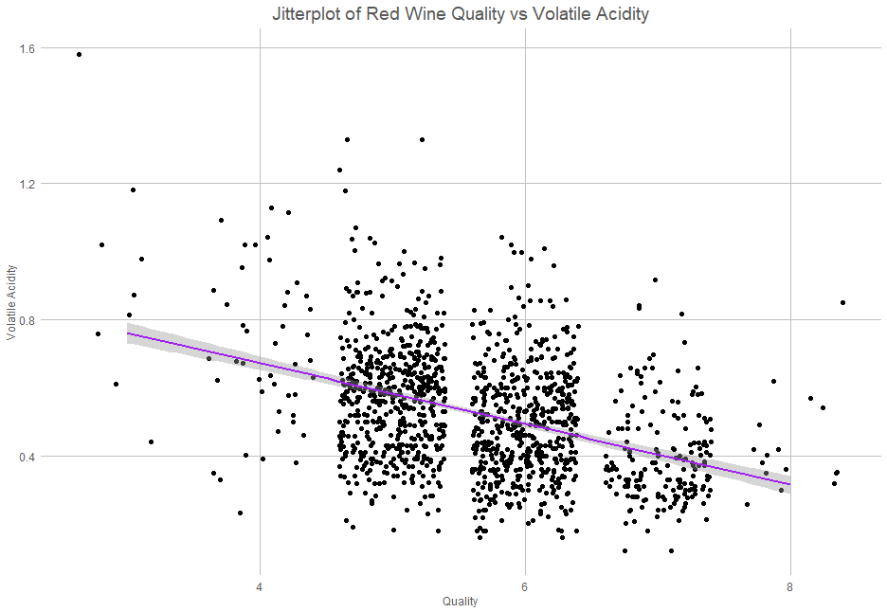
Variable Analysis – V. Acidity
White Wine
Red Wine
Notes:
Payden

Slide 17
02
Important Factors

Slide 18
Composition of wine
Density | It's one of the strongest predictors and lower values are associated with higher wine quality. There's an average density of 0.9924426 in high quality wines.
pH | PH is the least strong predictor however still relevant as a variable since it shifts upward for higher quality wines. The average pH level is 3.226582 in high quality wines.
Residual Sugar | As quality increases, sugar level does slightly decline. The average residual sugar level is 5.311392 in higher quality wines.
Alcohol | Higher-quality wines tend to have higher alcohol content. The average alcohol content is 11.7443 in higher quality wines.
Citric Acid | Higher levels of citric acid are associated with higher quality wines. The average critic acid level is 0.3331013 in higher quality wines.
Acidity | Fixed acidity is mostly consistent in other classes of quality but does decrease in higher quality wines Volatile Acidity tends to be lower in high quality wines. This is typical since high volatile acidity (which can lead to off-flavors) is often associated with poorer-quality wines.

Slide 19
Key Factors and Suggestions
Density
Alcohol Content
Sugar
Sugar levels may depend on type. For an average level, can be between 4 and 5.5
Lower values of density will help improve the alcohol and sugar level. Best to have values between 0.98 and 0.99.
Stronger wines are associated with higher quality. Best to have abv between 11.5% and 12%.
Fixed Acidity
Volatile Acidity
Types and Locations
A balance in acidity can contribute to freshness. Recommended to have an average level of 6.817089 to maintain that freshness.
A good level of volatile acidity attributes to a fresher, clean taste. To maintain that flavor, the balance level is recommended at 0.2974051.
There's a trend associated with white wines having higher quality in California. However, red wines are fewer in the dataset.

Slide 20
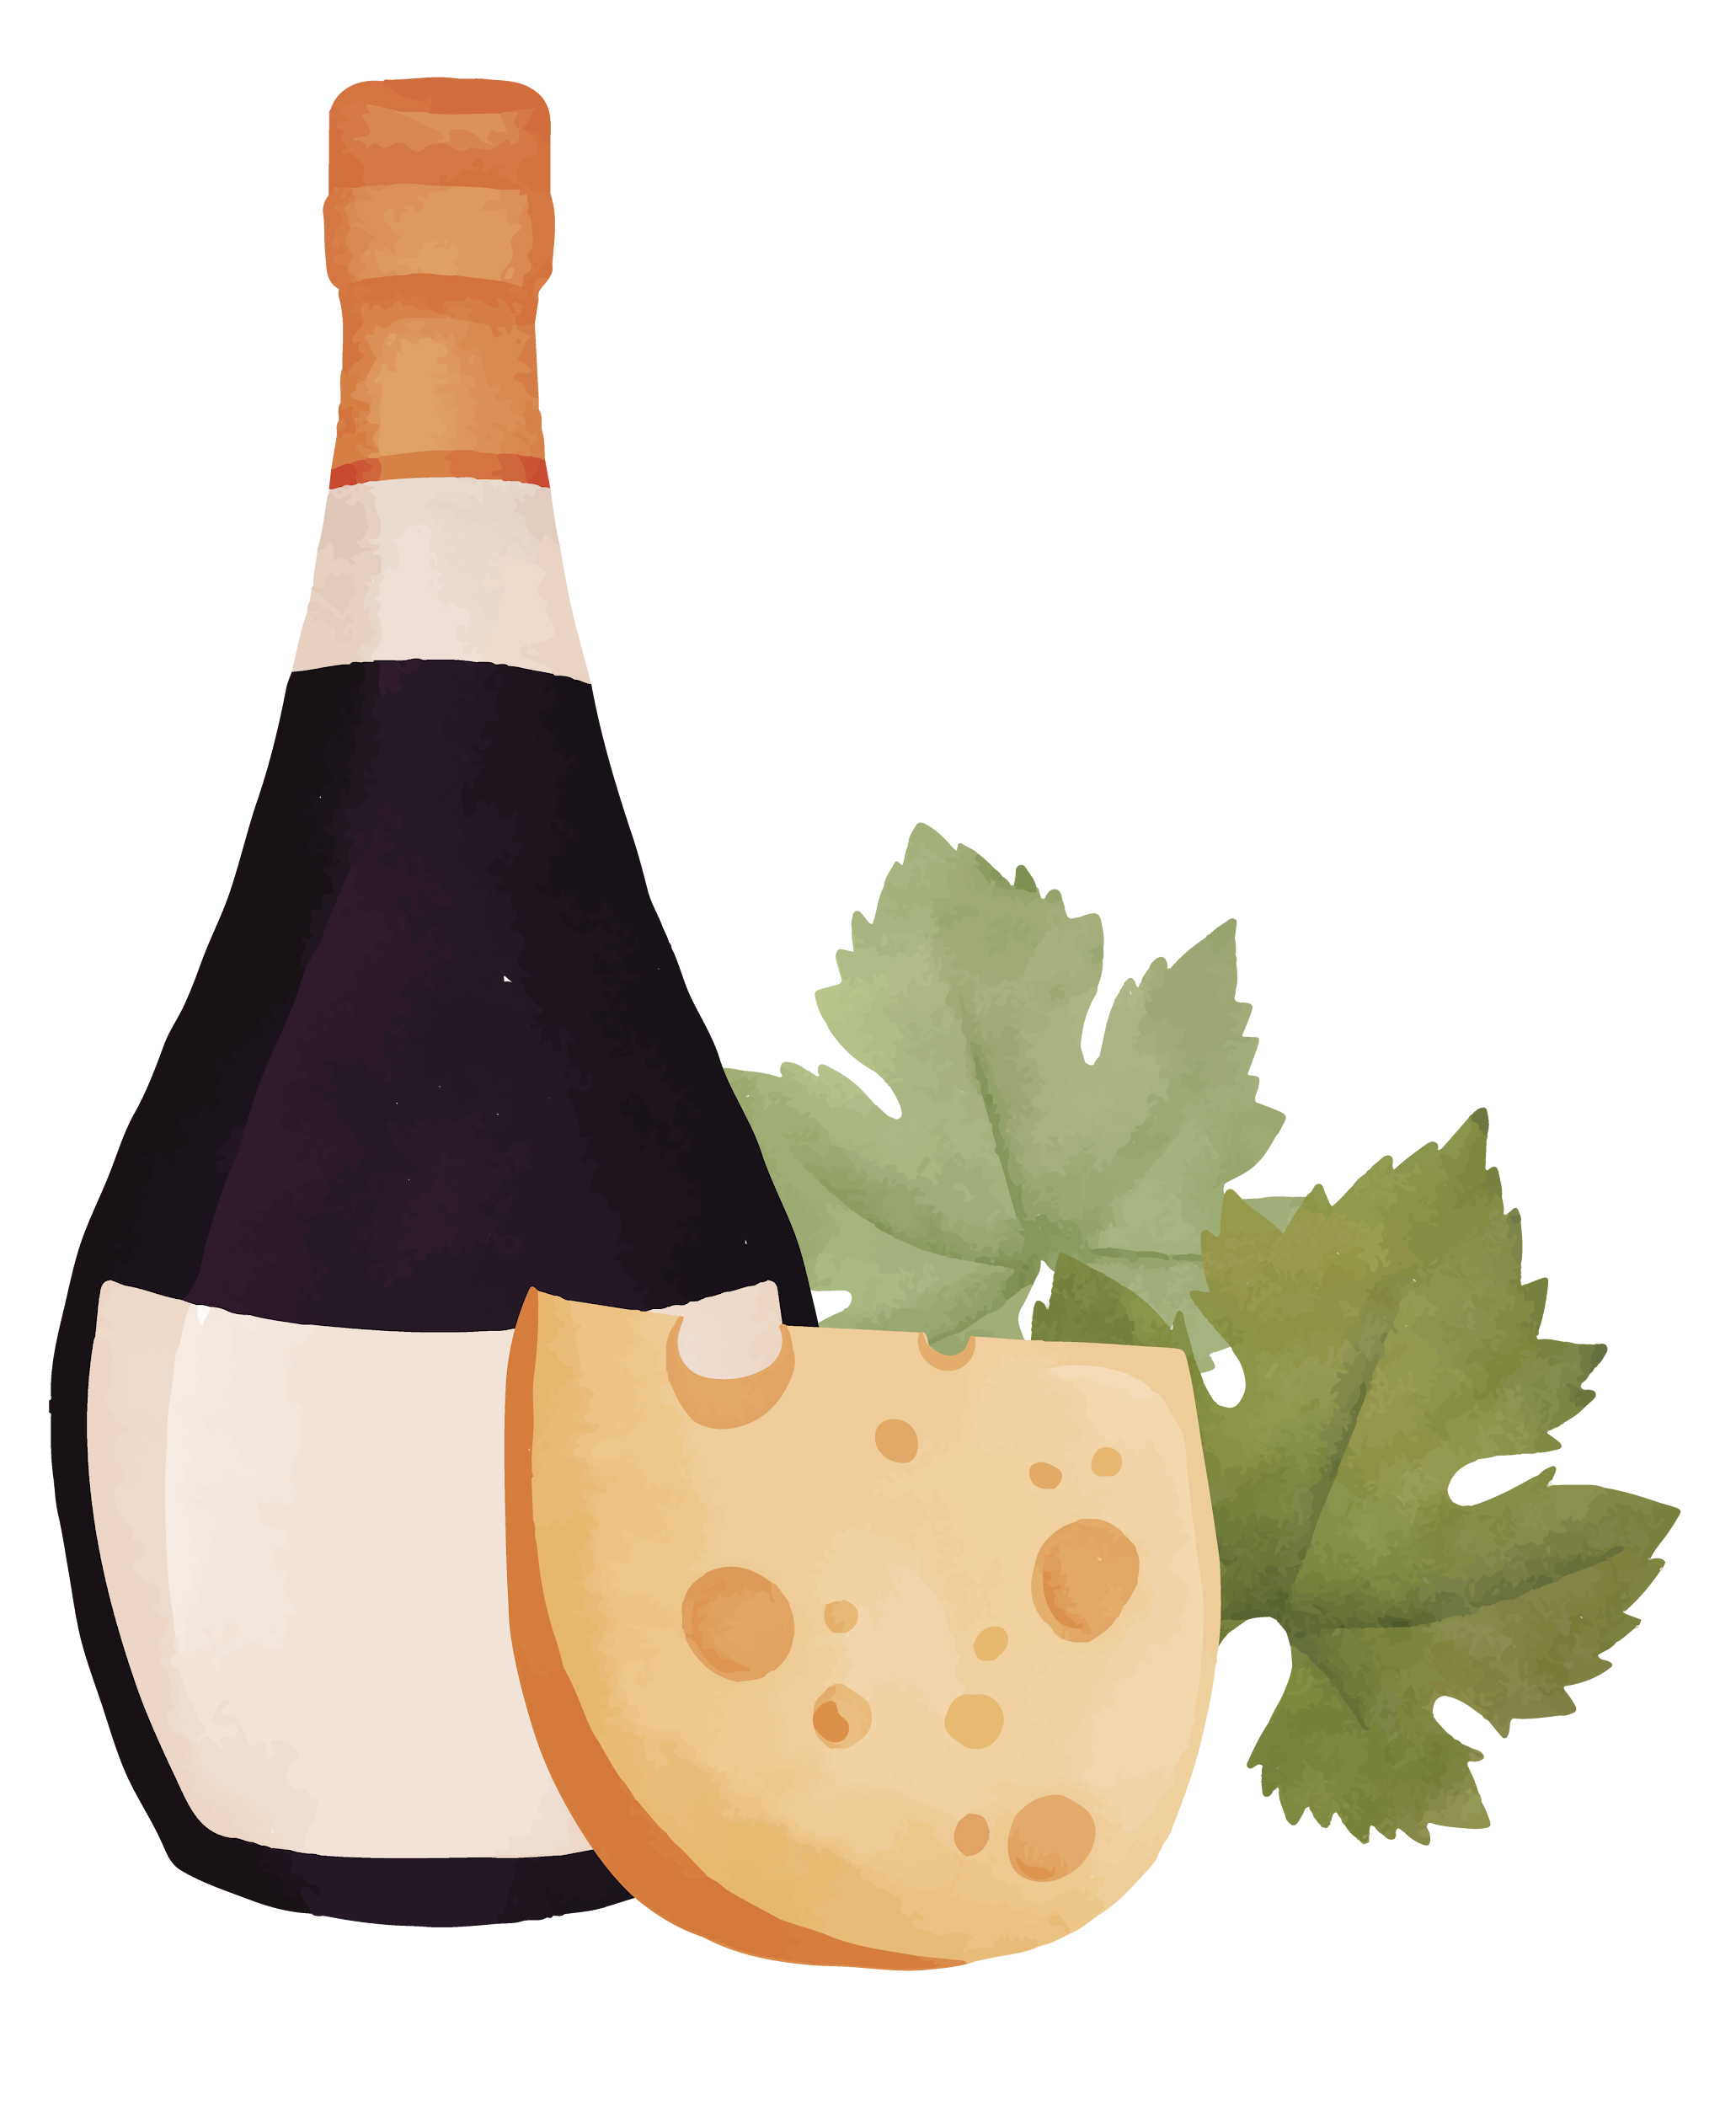
Potential Covariates
There were potential Covariates with Alcohol content
Density
Residual Sugars
Based on the fermentation process when more of the sugars are fermented out the alcohol content increases, and the alcohol content reduces the density. There is likely additional effects to the quality due to the effects of fermentation. These are the most influential covariates that we estimated.

Slide 21
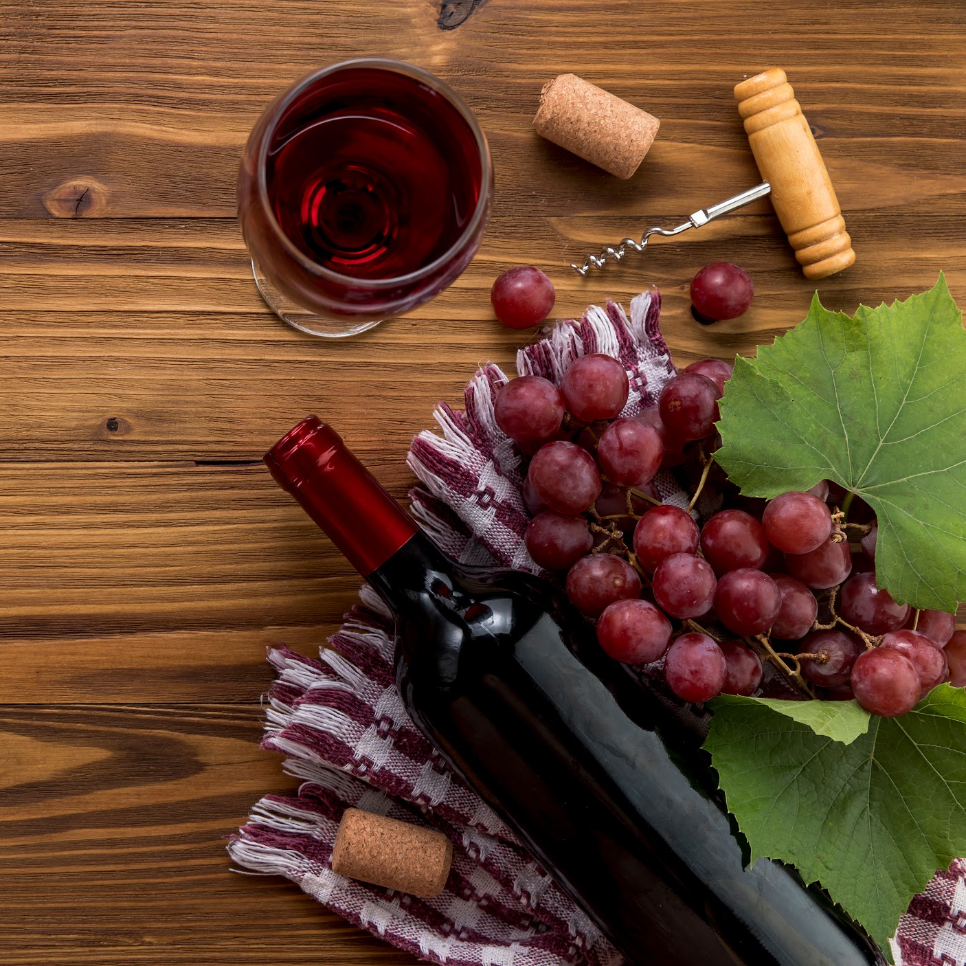
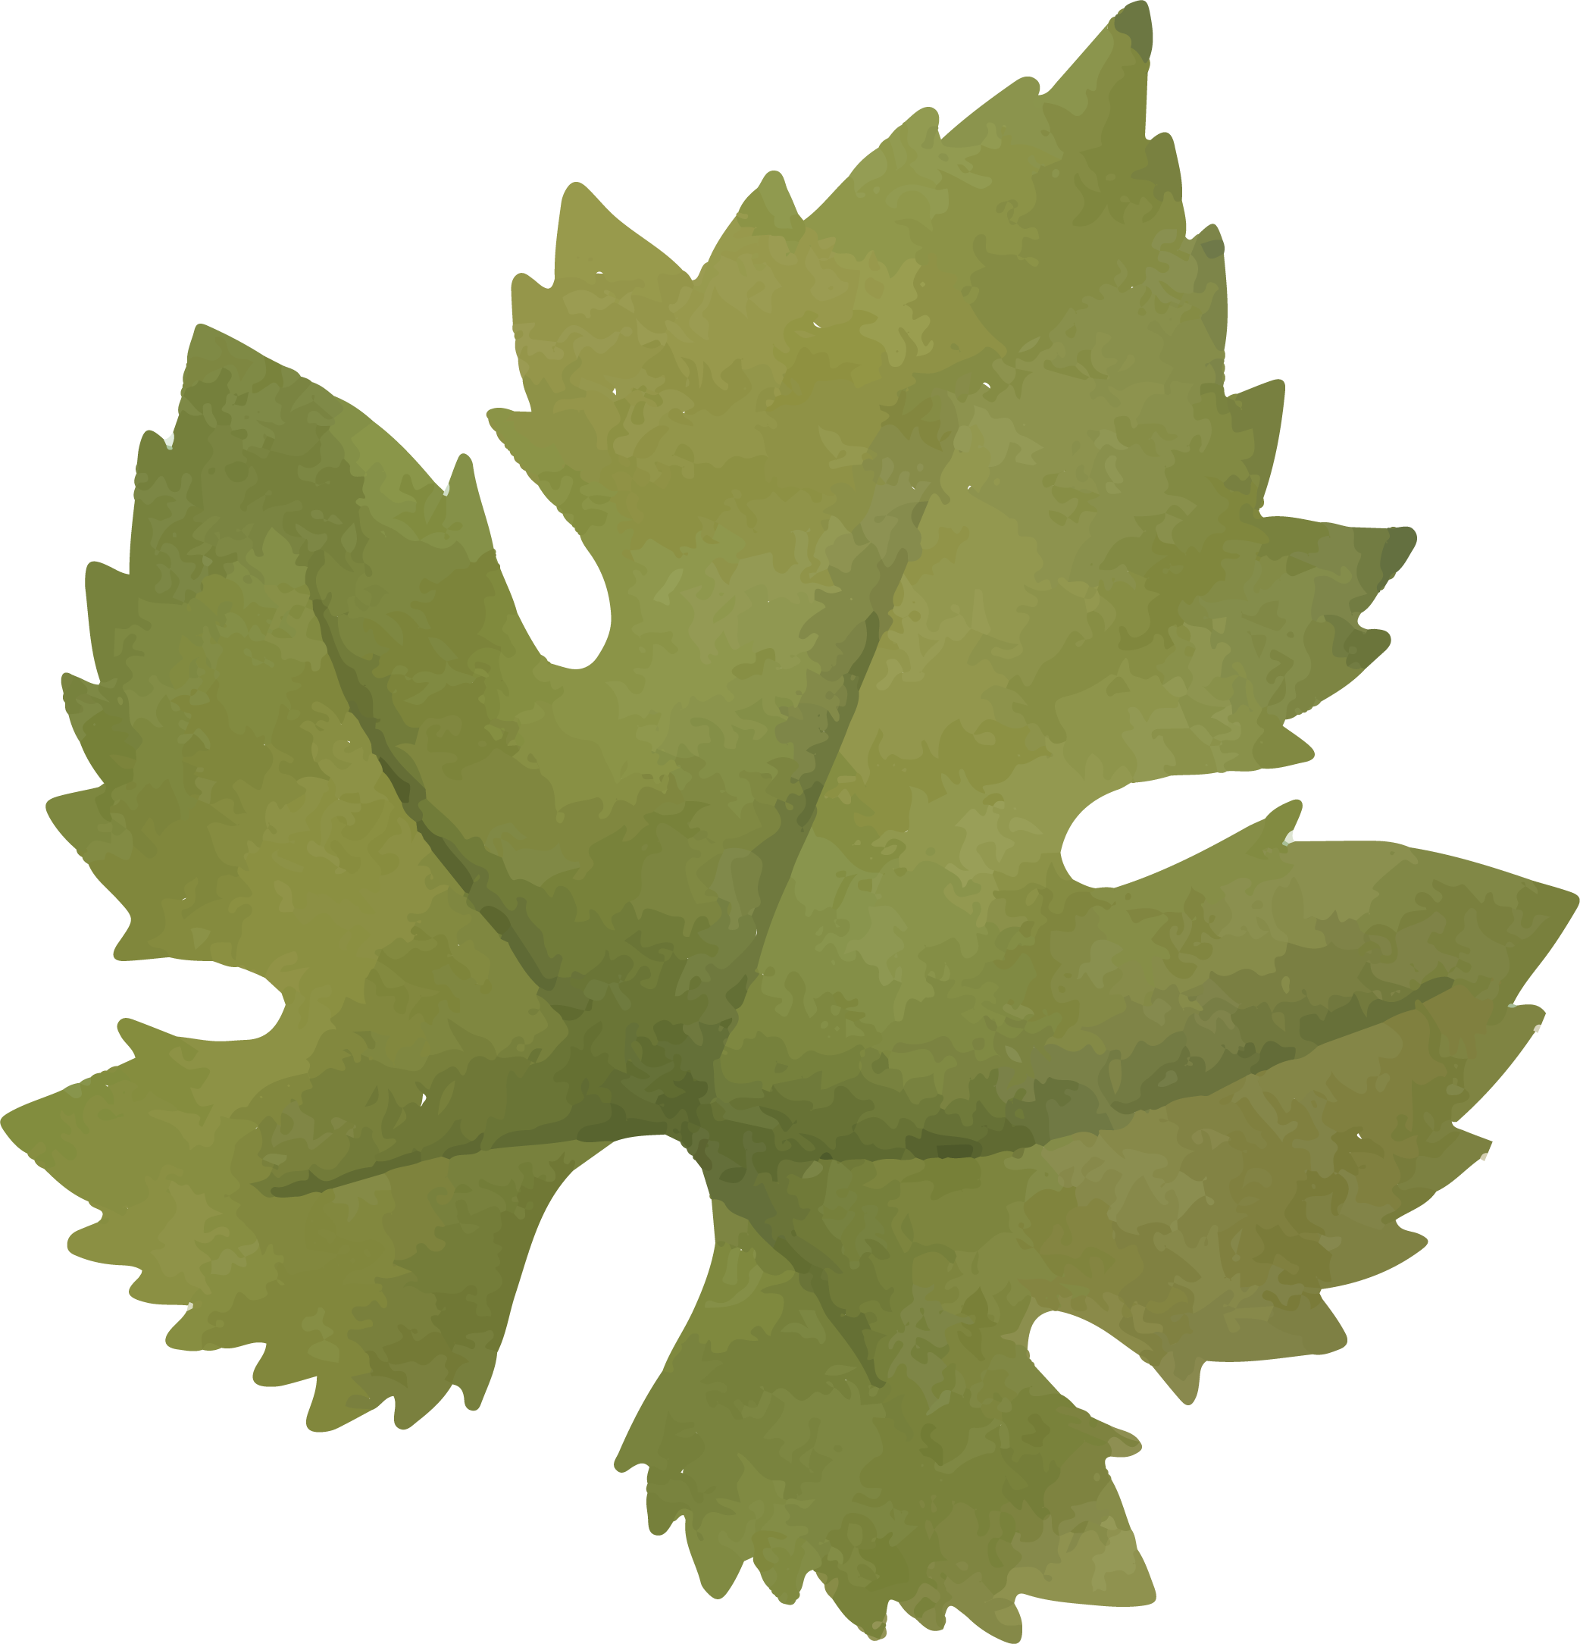
Conclusion
There are many factors involved in making great wine. We recommend to focus on low density, high abv, and to find a good balance of sugar and acidity.
Red wine

Slide 22

Thanks!
Do you have any questions?
Please keep this slide for attribution

Slide 23


